Slide 1

Replacement of Water Main in Central Park West Between West 81st St. and West 85th St. Project ID: MED682
Zohran K. Mamdani
Mayor
Eduardo N. del Valle Acting Commissioner
March 10, 2026

Slide 2

About the Project
Data
Why the Project is Necessary
Community Benefits
Map / Work Locations
Construction Overview / Sequence of work
DEP Program
Impacts and Mitigation
Outreach and Notification
Q & A
Agenda

Slide 3
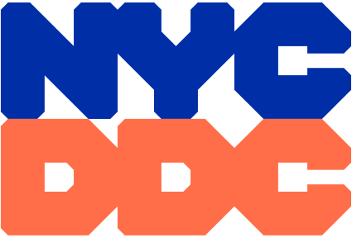
Project Data
Project ID: MED-682
Notice to Proceed (NTP): January 5, 2026
Anticipated Start: February 2026
Anticipated Completion: Summer 2028
Contractor: MFM Contracting Corp.
Contract Value: $10.9M
Typical Work Hours: Vary based on location
Holiday Embargo: Mid-November – January 2nd
3

Slide 4
Why Project is Necessary
Approximately 2,700 L.F. of aging 12-inch cast iron water mains have been identified as in need of replacement.
Proactively replacing these pipes with new Ductile Iron Pipe, will extend the pipe service life, protecting streets, property, existing utilities, and MTA infrastructure.
Identifying and replacing old and defective water main valves will ensure fewer residents/businesses/organizations are affected by planned water shutoffs or emergencies.
Lead service lines from water main to property meter (where applicable).
4

Slide 5
Community Benefits
Numerous community upgrades will include:
Improved water pressure
Improved water flow
Improved service reliability
Improved fire protection in the area
Lead service lines to be replaced with copper from the distribution water main to the house connection (where applicable)
Disturbed curb, sidewalks, and roadways will be reconstructed and resurfaced upon completion
5

Slide 6
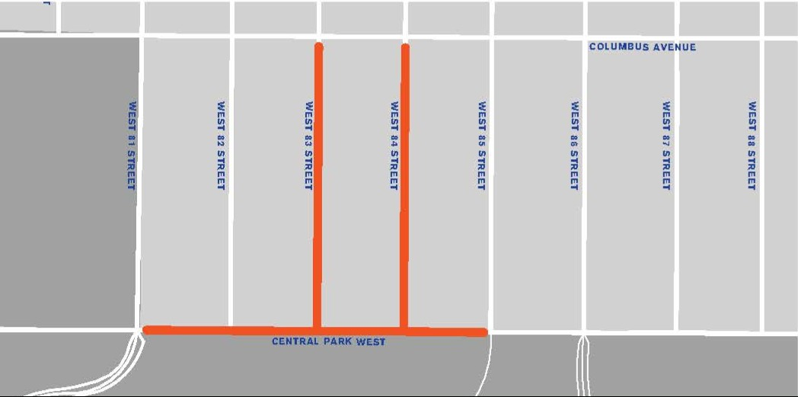
Project Location Map
Work will be conducted in Central Park West in three main areas:
Central Park West from 81st Street to 85th Street (4 Blocks)
83rd Street from Columbus to Central Park West (1 Block)
84th from Columbus to Central Park West
(1 Block)
6

Slide 7
Project Outreach
Completed Outreach:
Central Park West from W. 81st Street to W. 85th Street
W. 83rd Street from Columbus to Central Park West
W. 84th from Columbus to Central Park West
Columbus from W. 81st to W. 85th
MCB7, CM Brewer, Columbus Avenue Business Improvement District
NYPD 20th Pct, FDNY
Outreach is ongoing
7

Slide 8
Construction Overview

Slide 9
Construction Overview
Preliminary Work
Permits, surveys, preconstruction photos, staging/storage of materials
Maintenance and Protection of Traffic (MPT) / mobilization of equipment and materials
Test pits
Test pits are excavated using hand tools or a small excavator to characterize subsurface soils for laboratory analysis and disposal planning.
Installation of tree guards
9

Slide 10
Construction Overview
Construction Operations
Saw cutting and trench set up
Utility infrastructure upgrades and relocation (as needed)
Water main installation operations
Fire hydrant installations
Lead service lines replacement (from distribution water mains to house connections)
Restorative Operations
Restoration of disturbed curbs and sidewalks
Water main trench / roadway restoration
10

Slide 11
Maintenance and Protection of Traffic:
The NYC Dept. of Transportation’s Office Construction Mitigation and Coordination
(DOT-OCMC) stipulated work hours will be:
Central Park West b/w West 81St St. & West 82nd St.:
9:00am – 3:30pm Monday through Friday
8:00am – 4:00pm Saturday
Central Park West b/w West 82nd St. & West 85th St.:
9:00am – 3:30pm Monday through Friday
8:00am – 4:00pm Saturday
West 83rd St. b/w Columbus Ave. & Central Park West:
7:00am – 4:00pm Monday through Friday
8:00am – 4:00pm Saturday
West 84th St. b/w Columbus Ave & Central Park West:
7:00am – 4:00pm Monday through Friday during school recess
9:00am – 2:00pm Monday through Friday during school session
8:00am – 4:00pm Saturday
11

Slide 12
Maintenance and Protection of Traffic (cont.):
Intersection of Central Park West & West 82nd, Intersection of Central Park West & West 83rd, Intersection of Central Park West & West 84th, & Intersection of Central Park West & West 85th:
9:00am – 3:00pm Monday through Friday
8:00am – 4:00pm Saturday
Intersection of Columbus & West 83rd:
9:00am – 3:00pm Monday through Friday
8:00am – 4:00pm Saturday
Additional Stipulations:
Parking will be restricted while work is in progress
Flaggers will be on-site as needed.
12

Slide 13
DEP / Lead Service Line Replacement Program Protocols

Slide 14
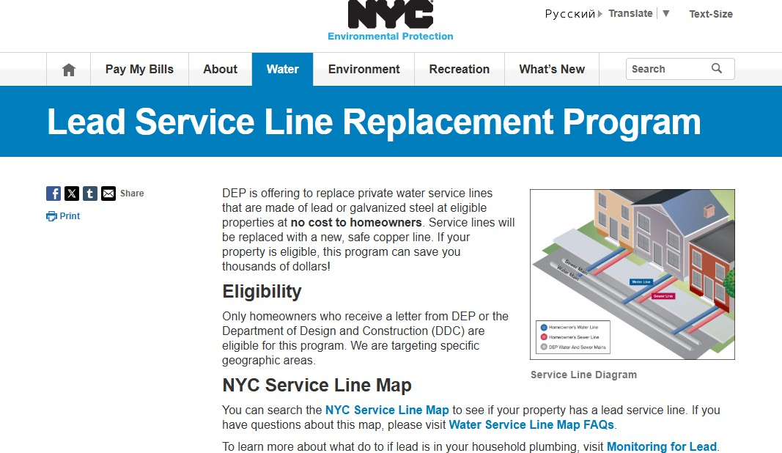
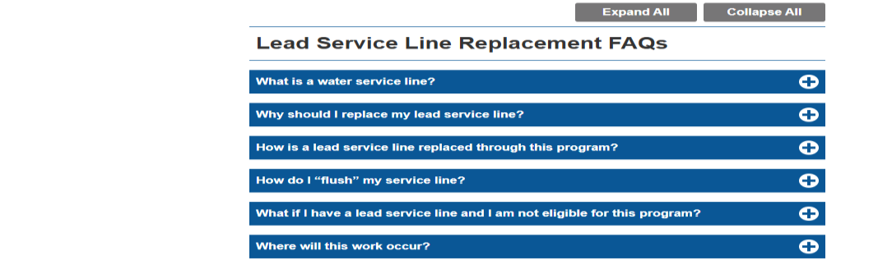
DEP Program
DEP website has information about their Lead Pipe Replacement program.
DDC is managing this project on behalf of DEP’s capital work - implementing the pilot program within target areas and qualified properties only.
If you have any questions or concerns about DEP Lead Service Line, please contact: ManhattanDEP@dep.nyc.gov and/or 311
14

Slide 15
LEAD PIPE REPLACEMENT PROGRAM PROTOCOLS
Lead Service Replacement requires a signed consent form. The City will attempt to communicate with Residents (4x’s) with the following information:
Once DDC’s project begins – DEP will send the DEP Lead Line Notification Letter.
Once DEP letter is sent - DDC will follow with a Notification Letter stating consent form sign off is required.
Once Consent Form is provided – Project liaison (CCL) will door-knock to follow up with resident’s permission and retrieve the signed consent form.
Once the CCL follows up again with the consent form, after that fourth and final attempt, we will consider the resident opted out of program.
NOTE: DDC field staff will reconfirm with residents who signed consent form, if replacement is feasible based on field conditions.
Lead Service Replacement is limited to targeted areas and properties identified or suspected to have Lead lines. Replacement will only qualify for the following:
Only for confirmed lead lines on eligible properties.
Only with resident’s permission and signed consent form.
Only actual replacements – considered feasible based on field conditions.
15

Slide 16
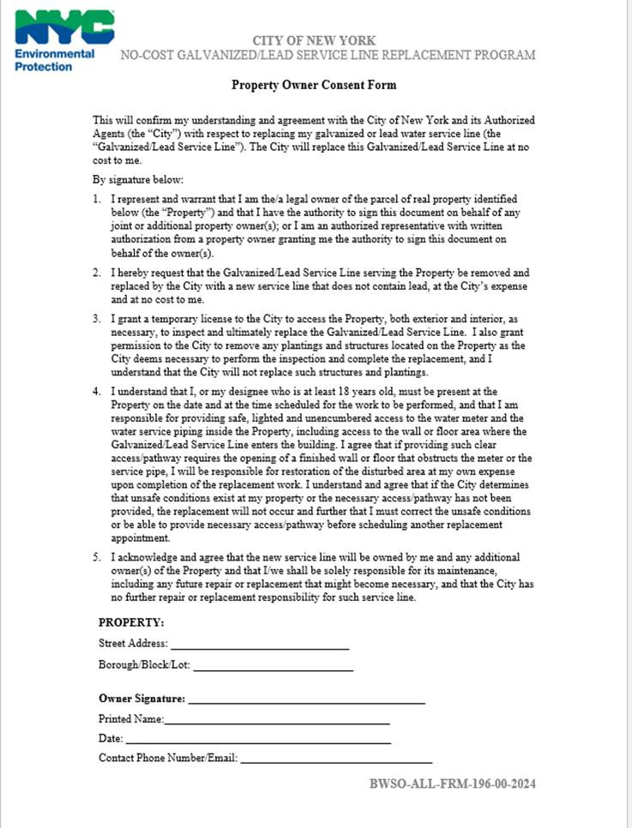
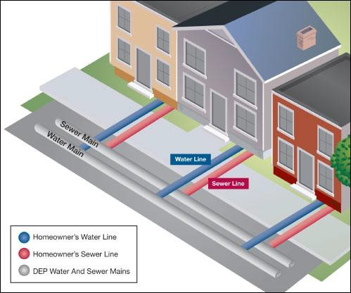
DDC / DEP Process & Protocols
Sample Consent Form
16
For a consent form email: centralparkwest81stccl@gmail.com

Slide 17
COMMUNITY IMPACTS & MITIGATION

Slide 18
Community Impacts & Mitigations
Street work is coordinated with DOT OCMC – Permit Stipulations
Contractor shall:
Work within DEP noise code regulations
Keep storage site area clean and safe
Traffic patterns:
Pedestrian/sidewalk access will be maintained at all times.
Temporary street closures and / or limited access may be necessary.
Sidewalk, driveway and/or loading dock access from the curb may be temporarily restricted while work is conducted (coordination will be arranged on a case-by-case basis).
Garbage/Trash pick up may be affected and will be coordinated with DSNY and appropriate stakeholders.
18

Slide 19
Community Impacts & Mitigations (cont.)
Water shutdowns:
A 72-hour Advance Advisory will be provided followed by a 24-hour confirmation or cancellation notice to impacted areas.
Specific instructions will be provided prior to water shutoff
If your water service is not restored within 3 hours of the indicated time on the shutoff notice, please contact the Community Construction Liaison (CCL).
Individuals with accommodations:
The DDC field staff will work specially with those individuals to minimize certain inconveniences when possible.
Anyone with special circumstances should contact the Community Construction Liaison.
We strive to minimize construction impacts and maintain a safe and well-kept project work site.
19

Slide 20
Community Impacts & Mitigations (cont.)
Project storage/staging:
Locations for storage/staging area will be coordinated and permitted by the NYCDOT.
Rodent control:
A rodent survey will be performed prior to construction.
Rodent control stations will be installed by a professional rodent control contractor.
Public transportation:
Bus stop routes within the project limits may be affected during the construction. The Community Construction Liaison (CCL) will be responsible for coordinating with the MTA and notifying the community.
20

Slide 21
Community Outreach

Slide 22
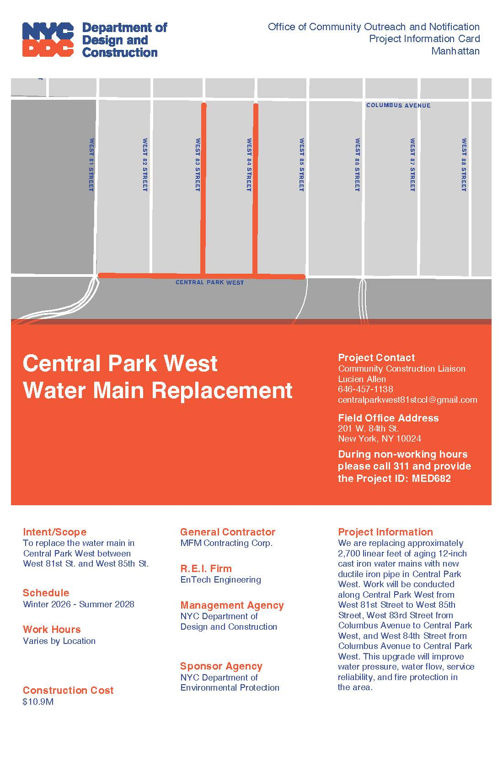
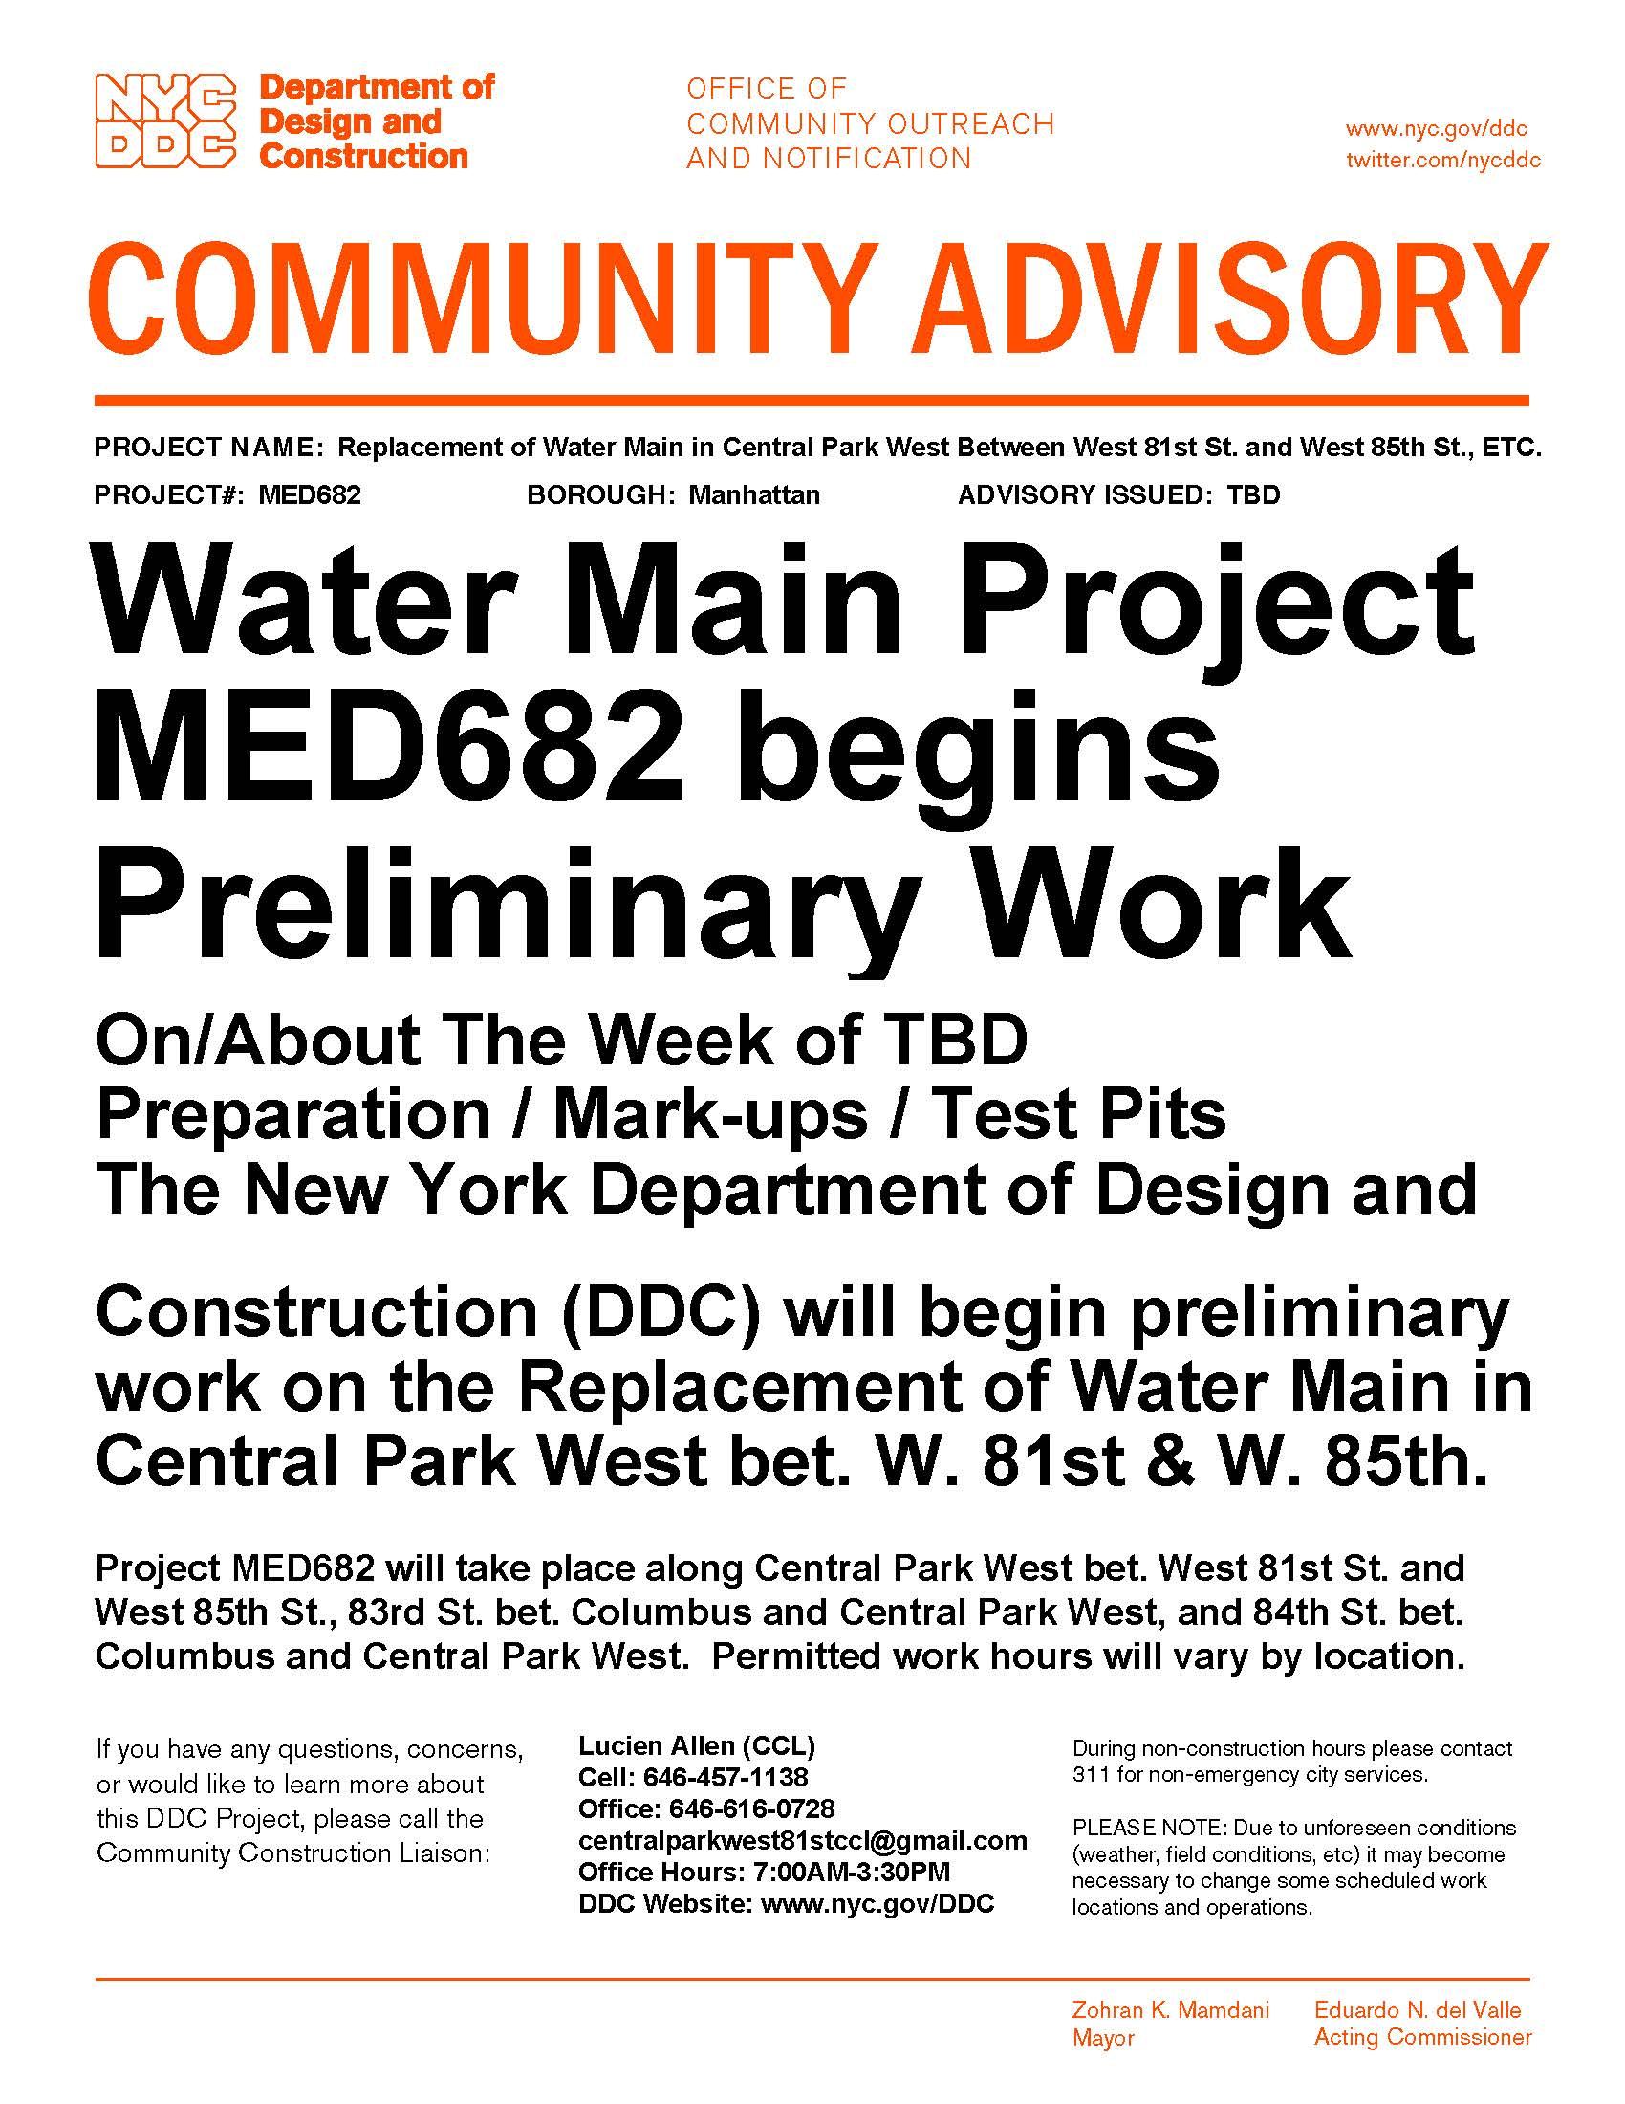
Community Outreach
How we communicate with you
In addition to the on-site CCL, we will distribute printed materials that are updated continually, prior and during the project, including:
Project Information Card
Community Advisory
22

Slide 23
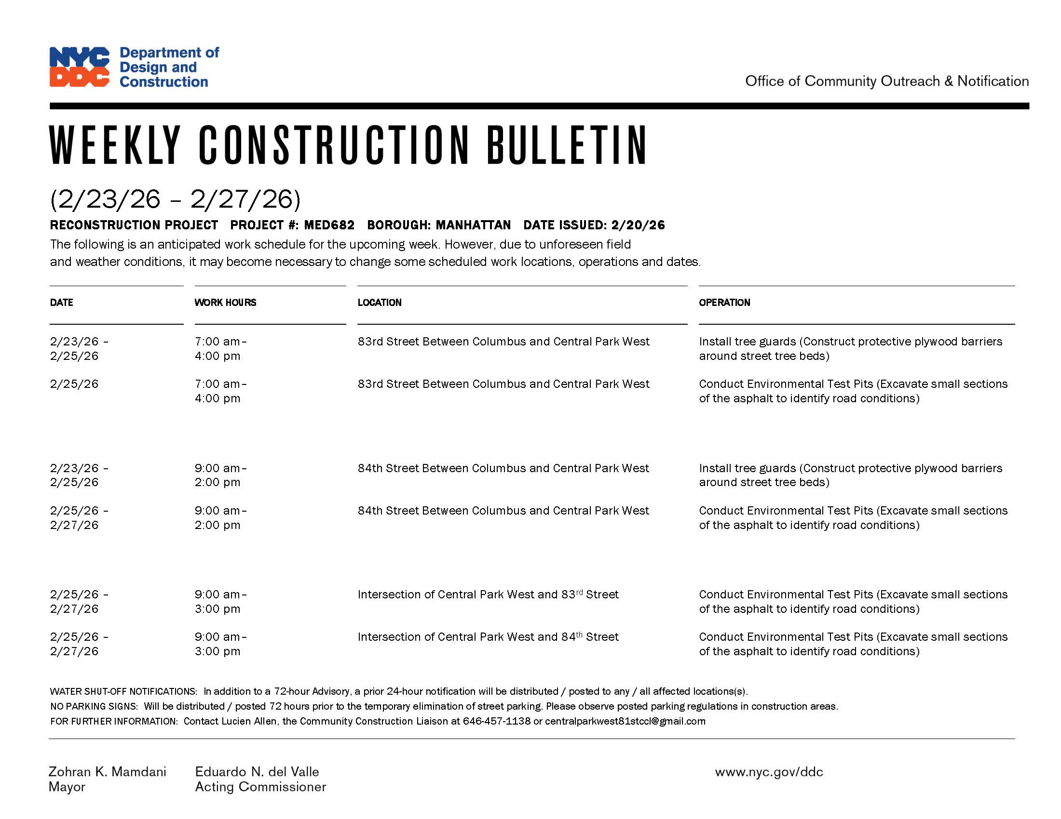
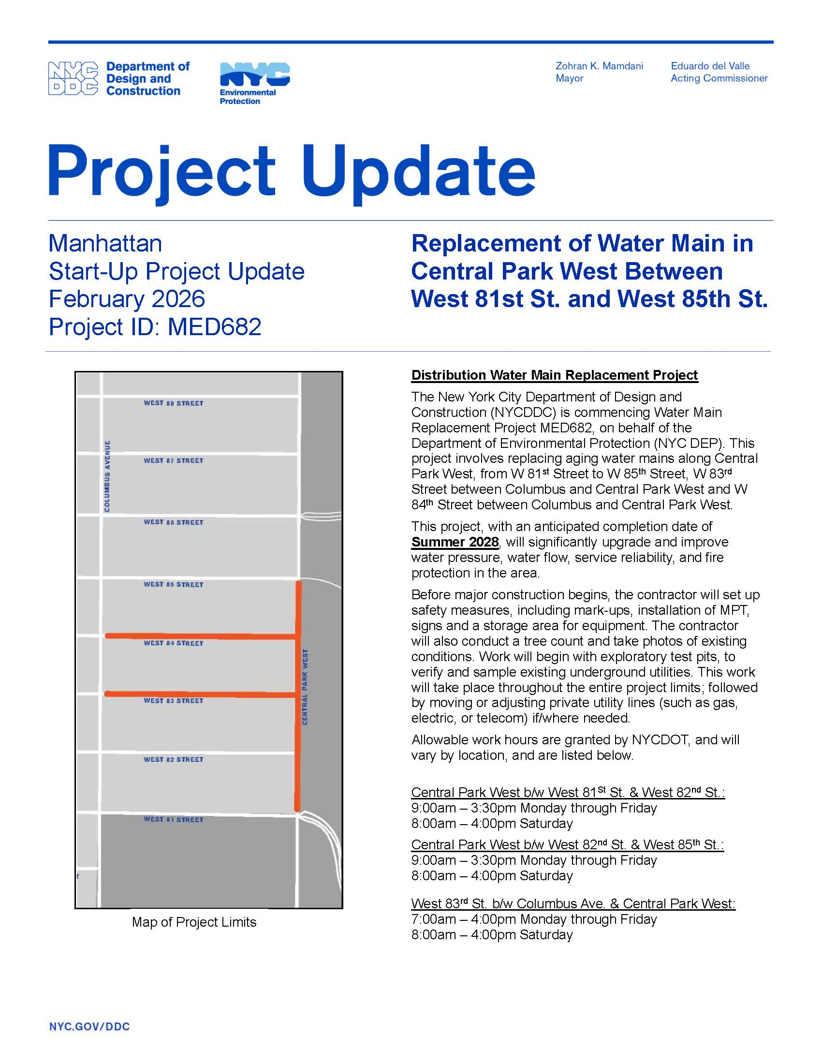
Community Outreach (cont.)
How we communicate with you
In addition to the on-site CCL, we will distribute printed materials that are updated continually, prior and during the project, including:
Weekly Construction Bulletin
Quarterly Project Updates
23

Slide 24
Community Outreach (cont.)
Community Construction Liaison (CCL) responsibilities are as follows:
First point of contact, maintain on-site presence and communications.
Identify, resolve, and/or proactively address issues and inquiries.
Distribute advisories and weekly construction bulletin as well as updates.
Provide 72-hour and 24-hour (confirmation or cancellation) advisories for work impacts by email and door to door.
Attend community board monthly DSC meetings, and other meetings as needed.
24

Slide 25
Community Outreach (cont.)
DDC’s Office of Community Outreach + Notification (OCON) works with Community Boards, Business Improvement Districts, local businesses, and other community stakeholders impacted by construction.
DDC has assigned Lucien Allen of EnTech Engineering as the dedicated on-site Community Construction Liaison (CCL). Anyone can sign up to receive updates from CCL; just contact CCL and ask to be added to email list. The CCL can be reached at:
Email: centralparkwest81stccl@gmail.com Phone: 646-457-1138
Field Office Location: 201W 84th Street, New York, NY 10024
Field Office Hours: 7:00AM to 3:30PM
25

Slide 26
Thank You!

